Slide 1
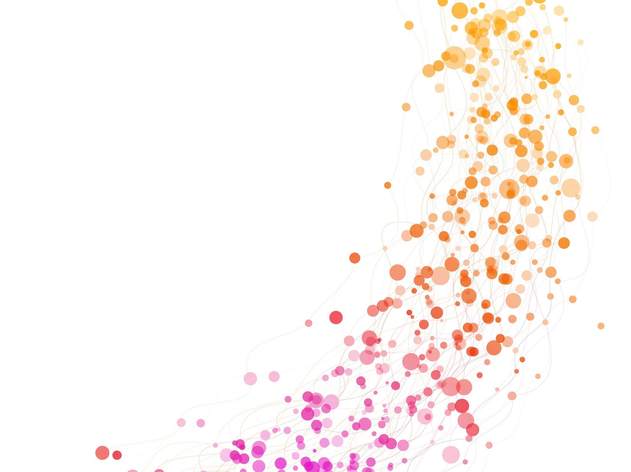
Chapter 17: Harmonics and Contrast Agents

Slide 2
Harmonic Imaging
Harmonic imaging and contrast agents are two of the most significant recent technological advances in diagnostic ultrasound.
These advances can increase accuracy and quality of images.

Slide 3
Harmonic Imaging
Creating an image from sound reflections at twice the transmitted frequency of the sound
Fundamental Frequency-frequency of the transmitted sound wave.
Harmonic frequency- twice the transmitted frequency. Also called “second harmonic”
Harmonics are multiples of the transducer frequency

Slide 4
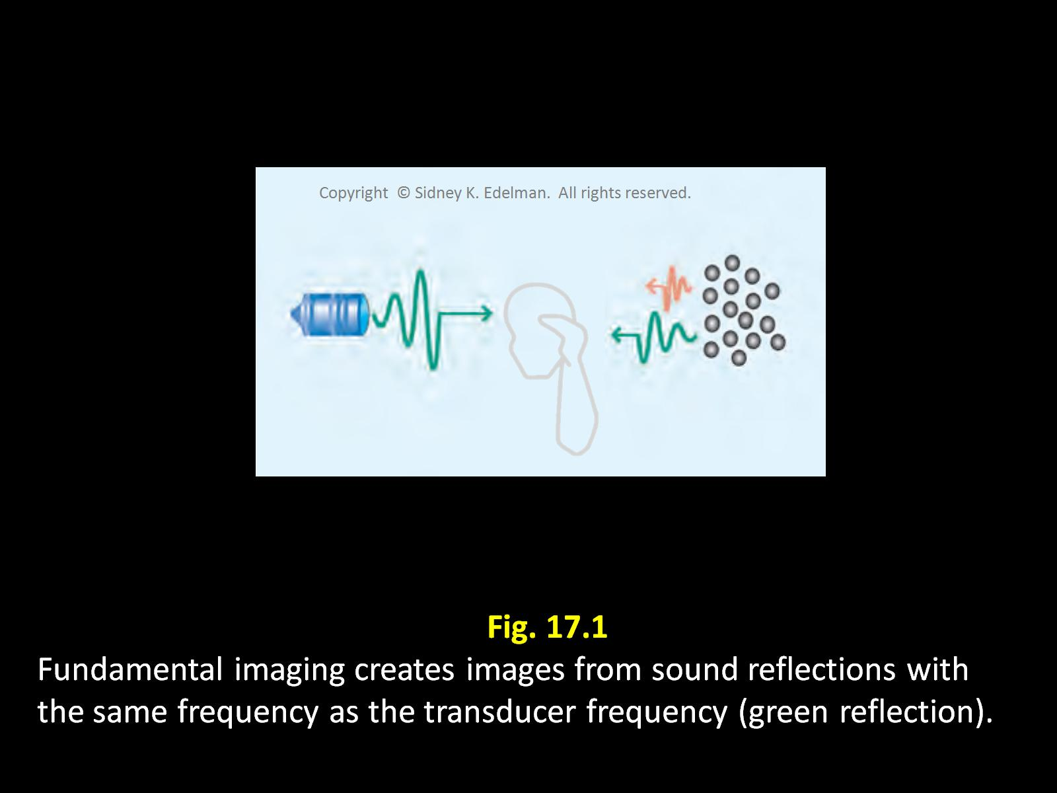
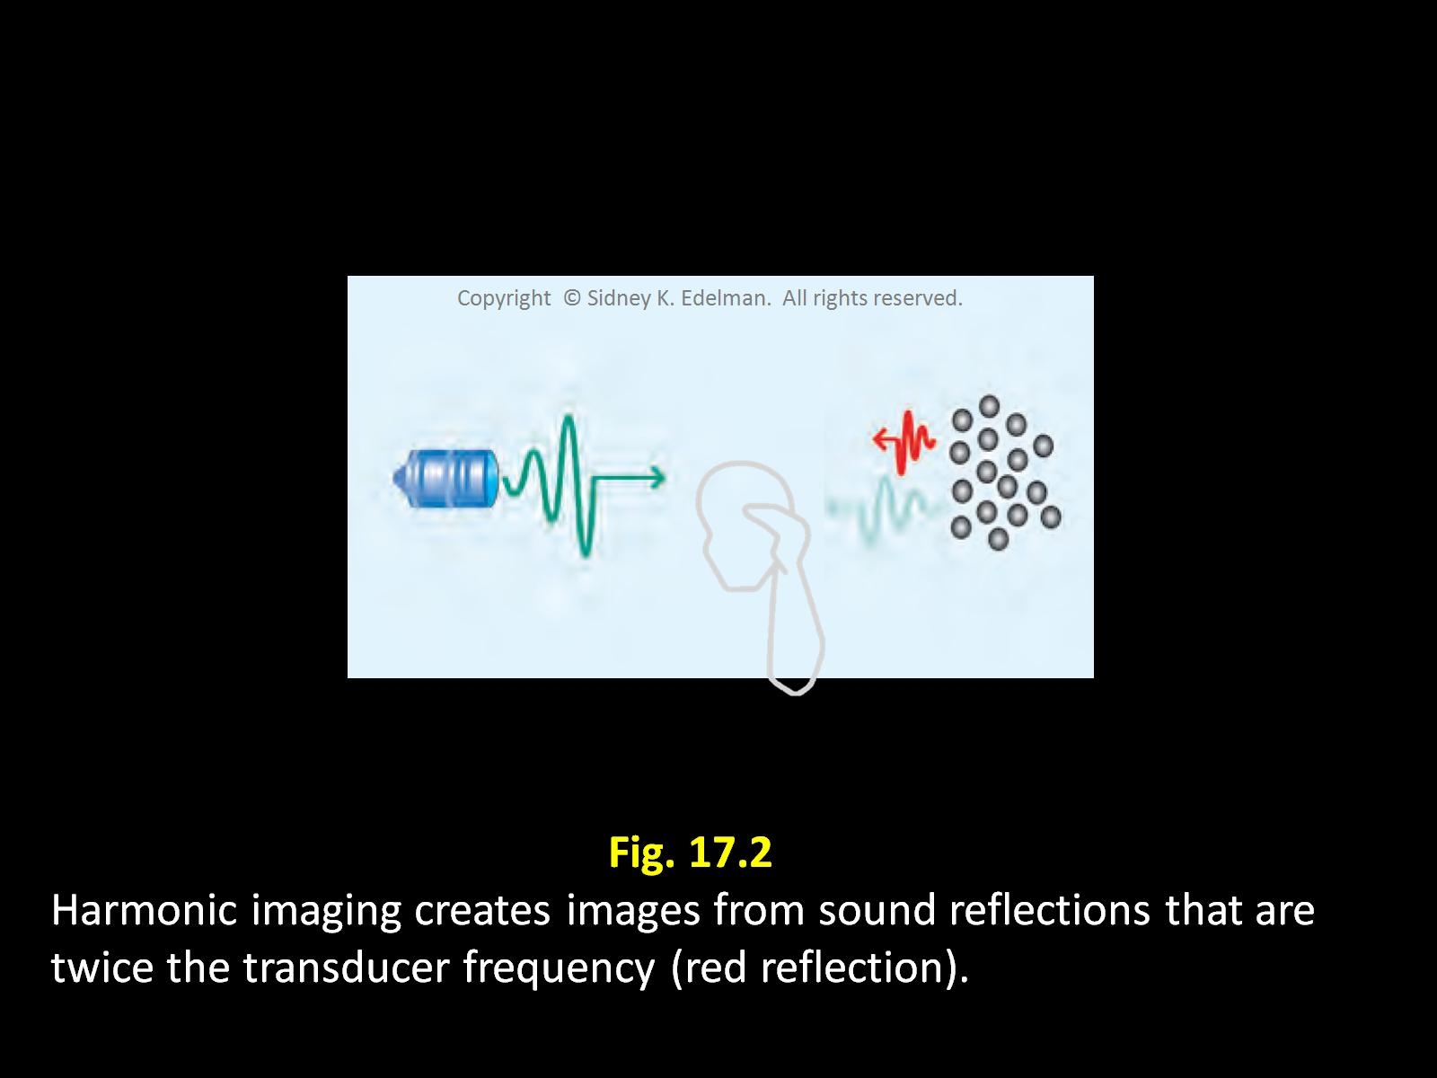
Fundamental F
creates images from sound reflections with the same F as the transducer (green)
Harmonic F creates images from sound reflections that are twice the transducer F (red)

Slide 5
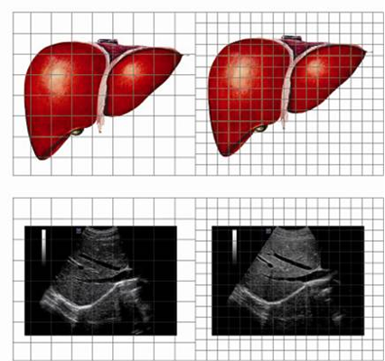
Harmonics
-A transducer transmits a sound pulse with a fundamental frequency of 2 MHz. In the harmonic mode, an image created from 4 MHz reflections will be displayed.
Because of this, the image will have better resolution

Slide 6
Linear & Nonlinear Behavior
As sound waves travel into the body, a minuscule amount of energy is converted from the fundamental frequency to the harmonic frequency.
Non-linear behavior
In instances where the fundamental image is suboptimal, the second harmonic data may be used to produce an image with improved quality or resolution

Slide 7
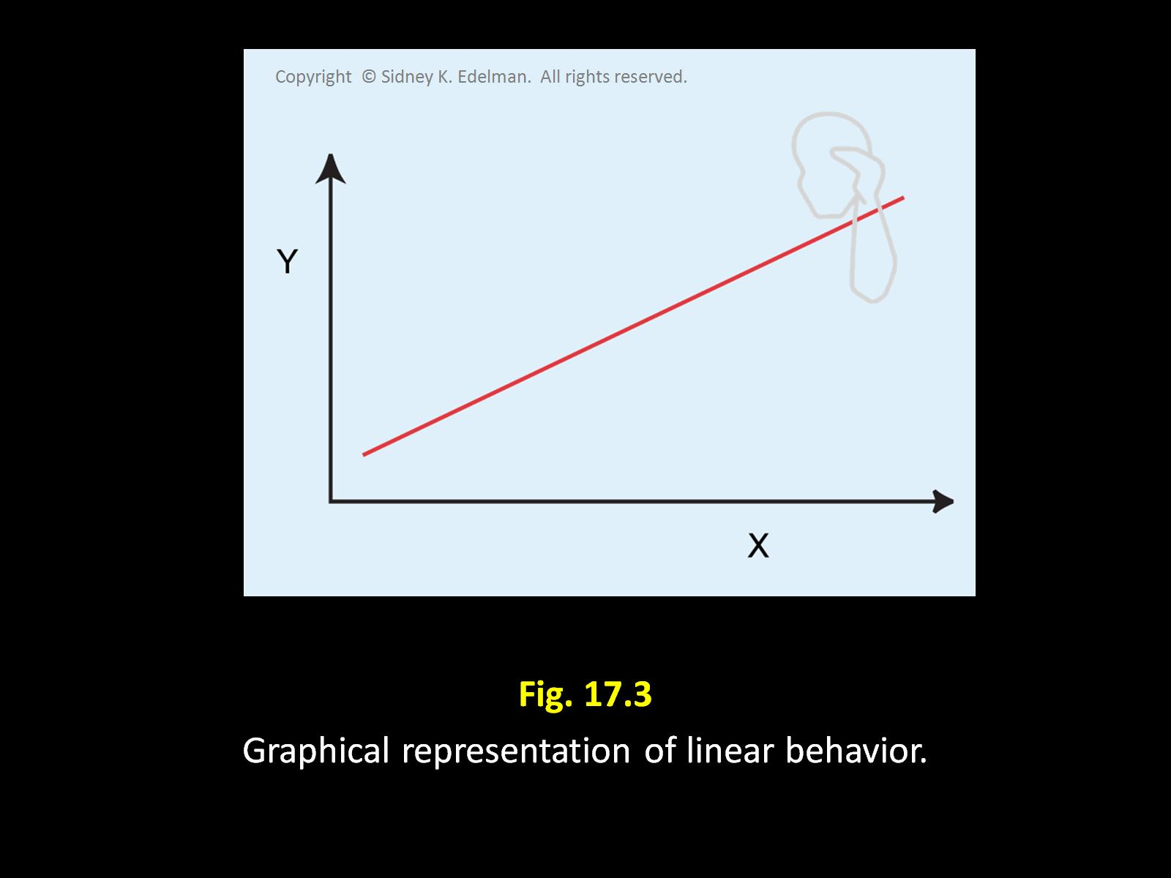
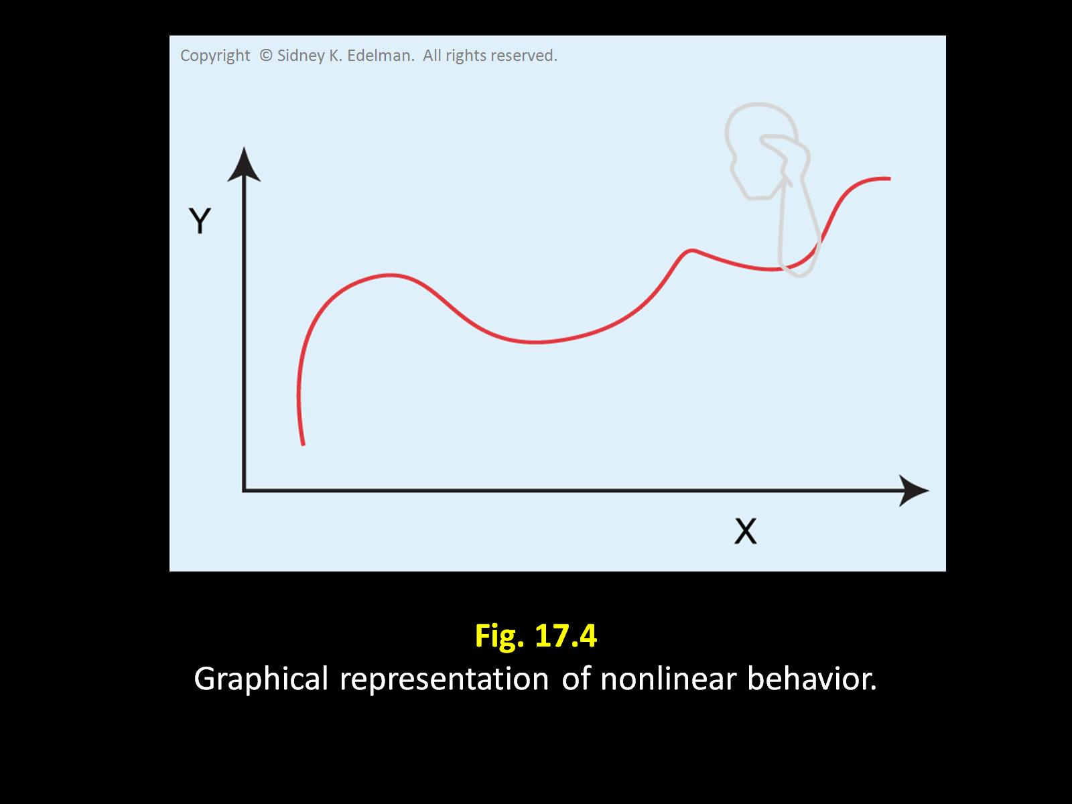
Linear means proportional or symmetrical. These systems respond in an even manner.
Nonlinear means irregular or disproportionate. A system is nonlinear when it behaves unevenly.

Slide 8
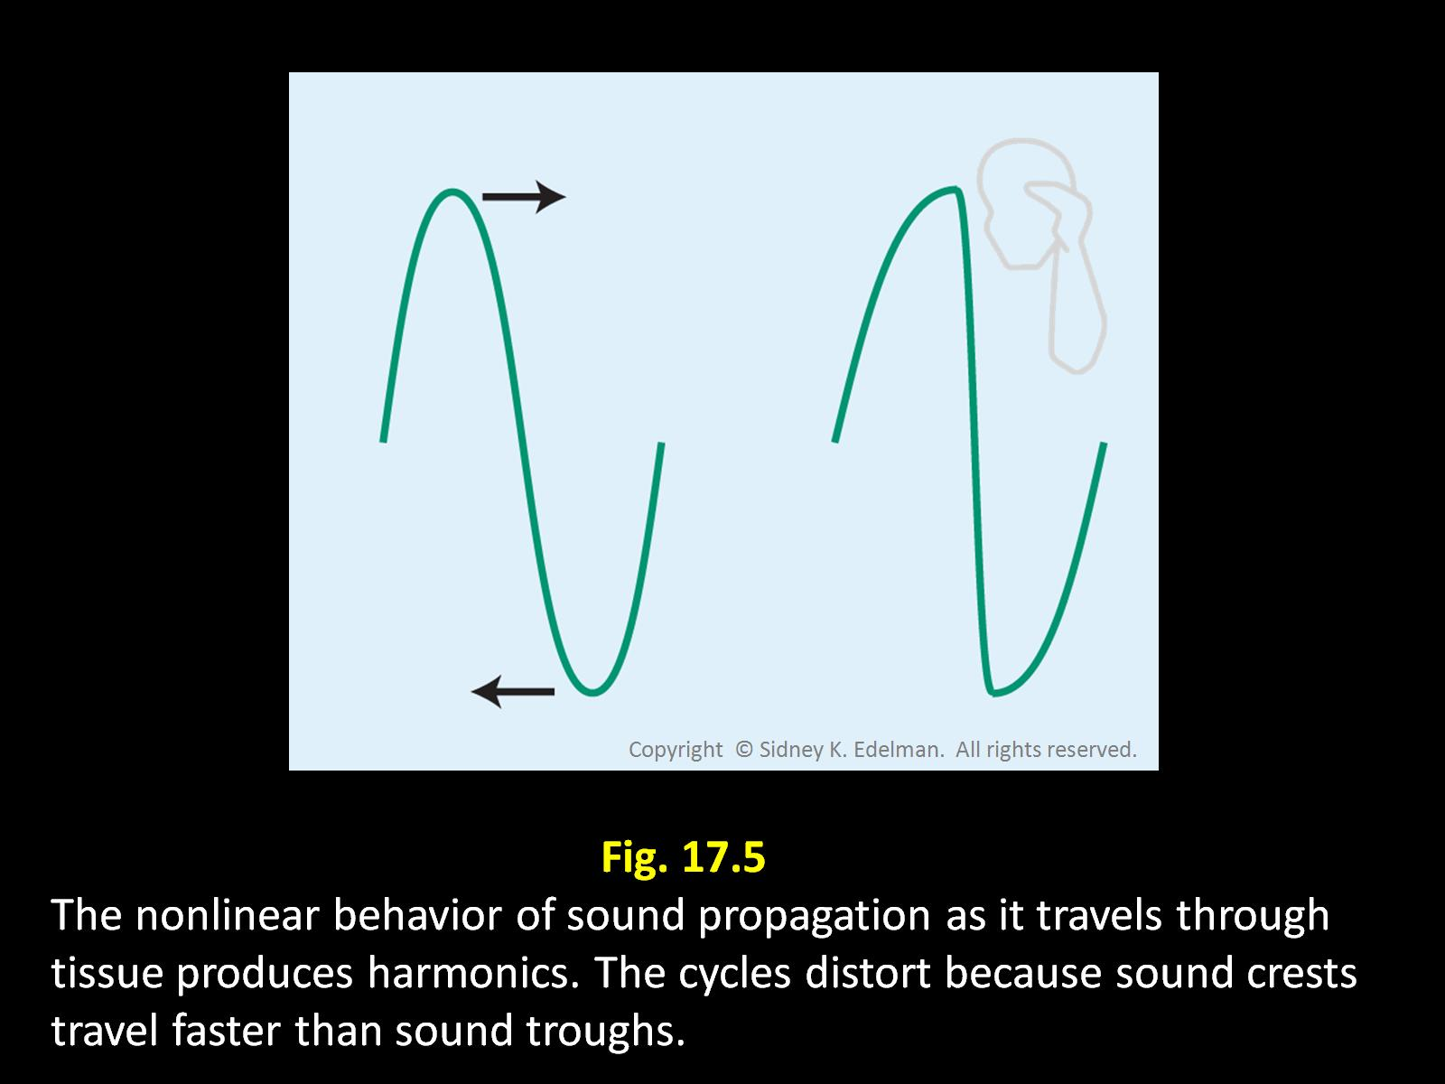
Tissue Harmonics
Created during transmission
Miniscule amount of Fundamental F converted to Harmonic F

Slide 9
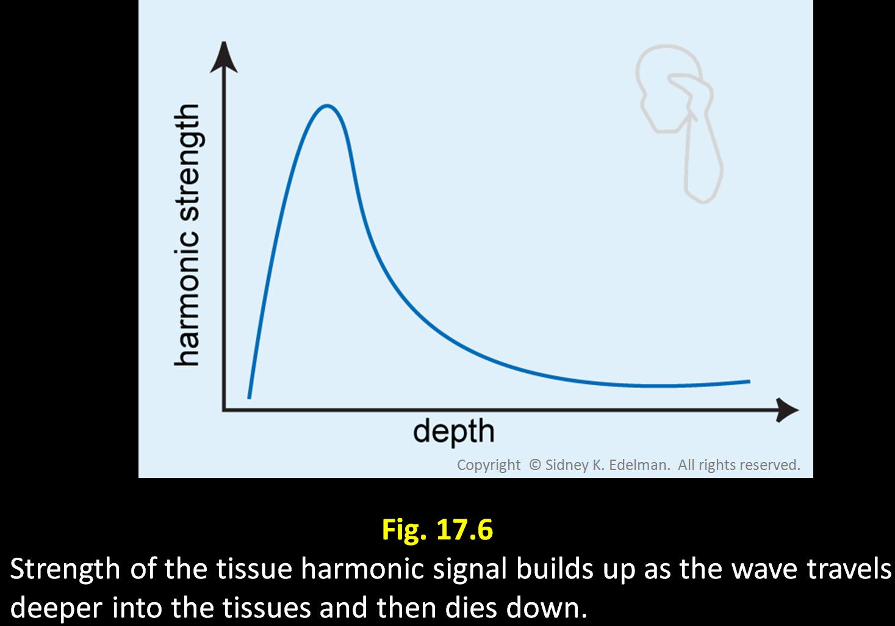
Gradual Signal Development

Slide 10
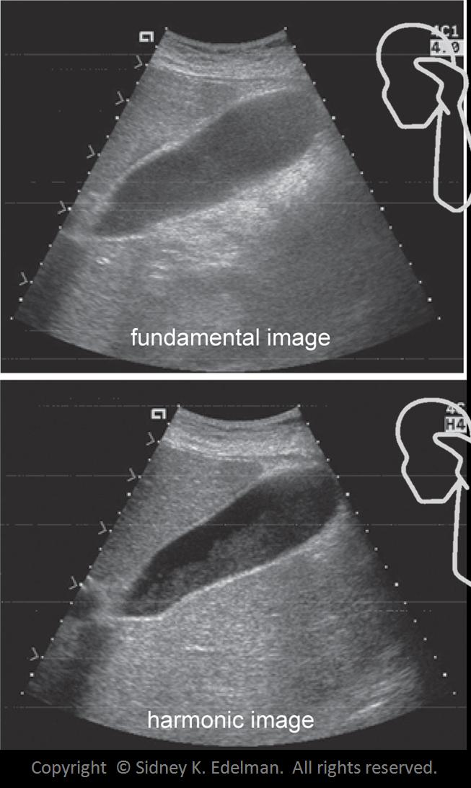
Gradual Signal development
Superficial areas- artifacts
Beam already strong
Superficial layers distort the sound beam
TH does not exist at superficial depths
Increases signal to noise ratio

Slide 11
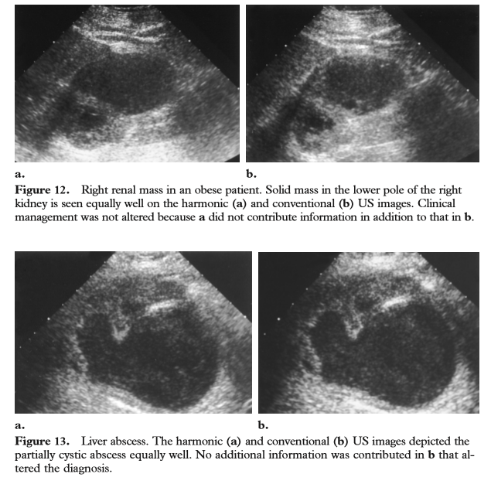

Slide 12
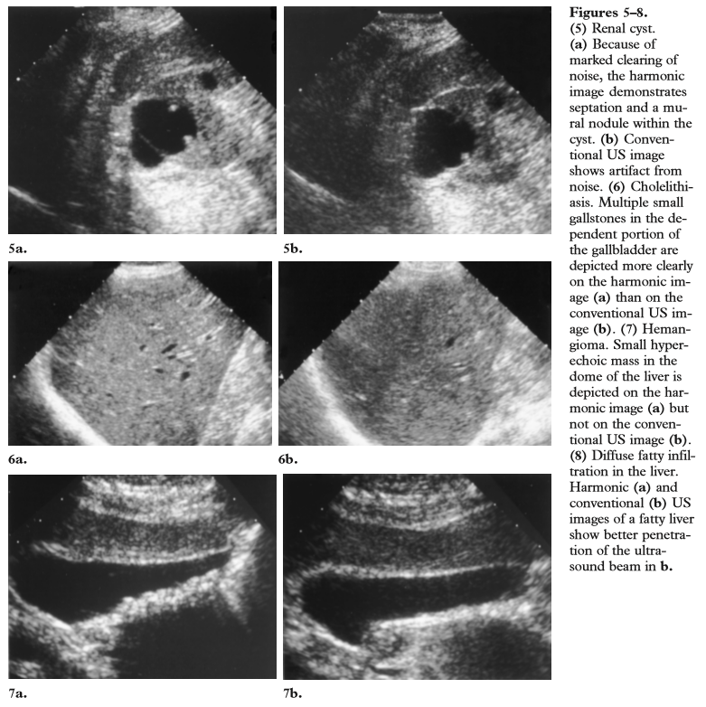

Slide 13

Another Form of Nonlinear Behavior
Further minimizes distortion
Relationship between signal strength and harmonic creation
Weak sound beams- no harmonics
Intermediate sound beams- miniscule amount
Strong sound beams- significant harmonics

Slide 14
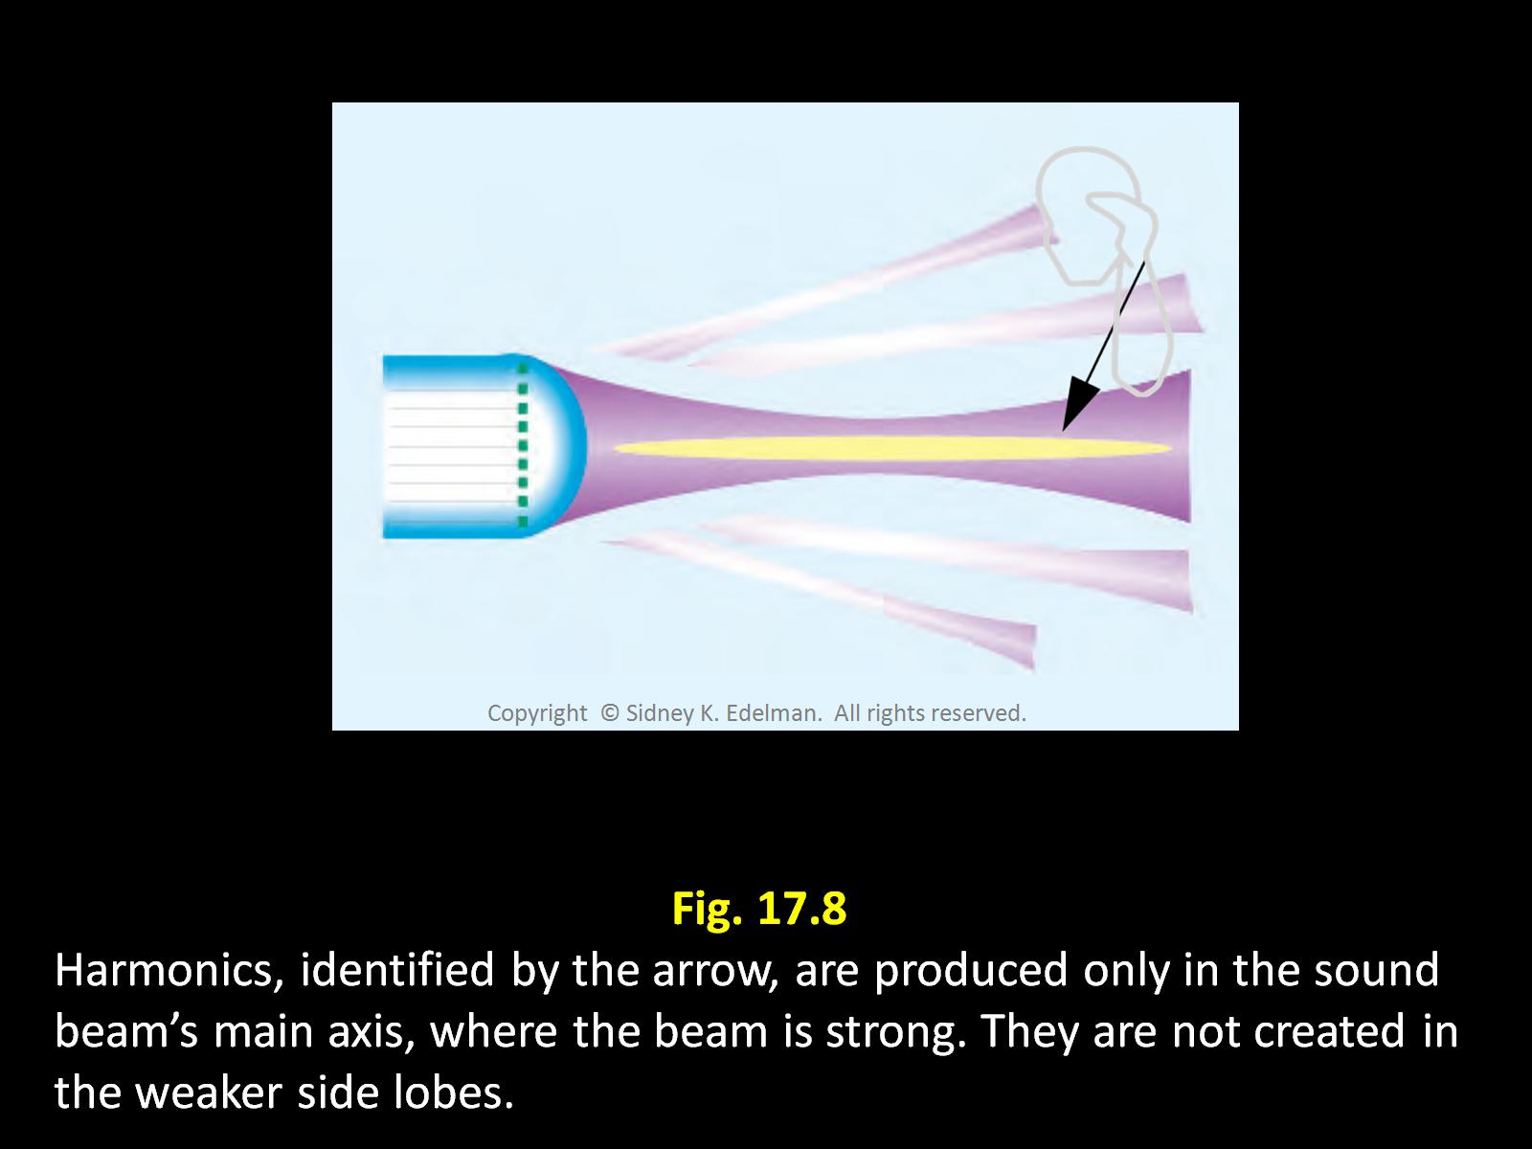

Slide 15
Strong Sound Beams Create Harmonic Signals
Beams that are most likely to create HARMONICS are least likely to create ARTIFACTS.
Side lobe and grating lobes- no harmonics created thus no exaggeration of lobes

Slide 16
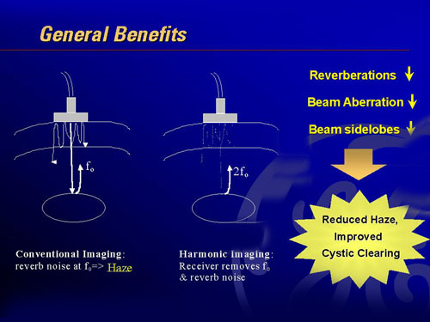

Slide 17
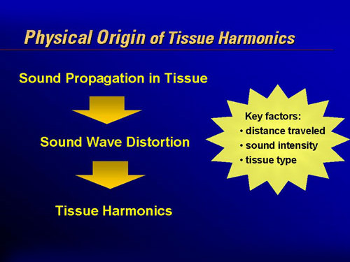

Slide 18
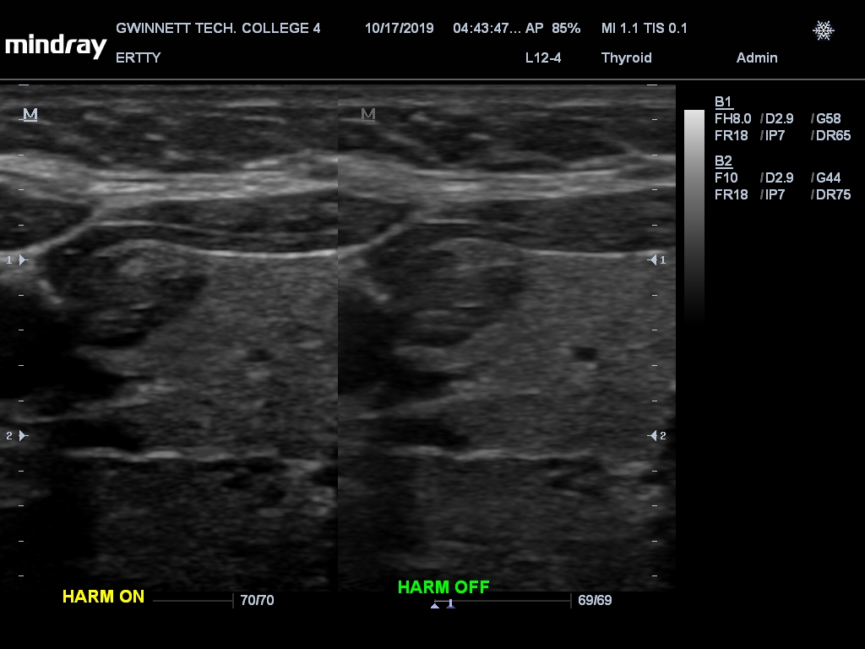

Slide 19
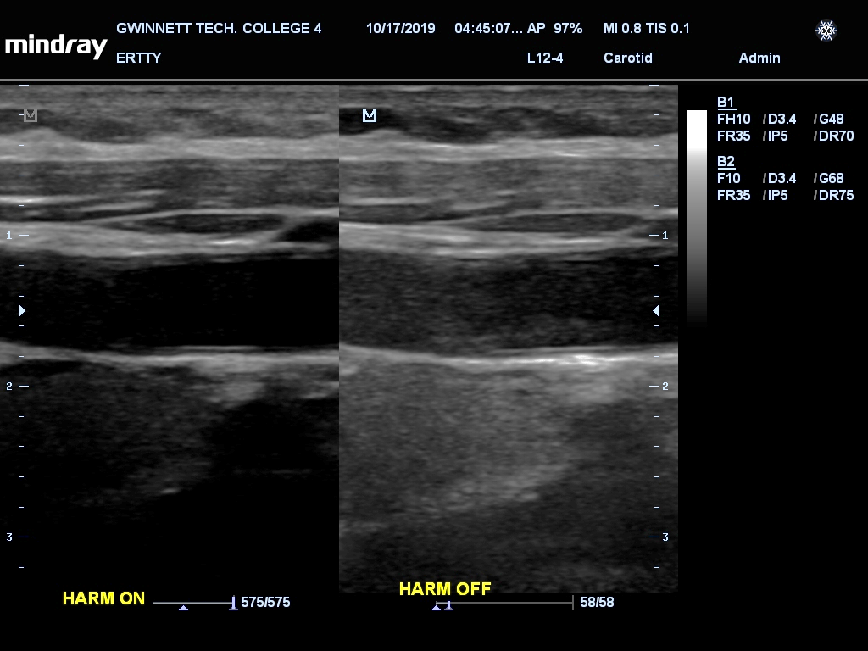

Slide 20
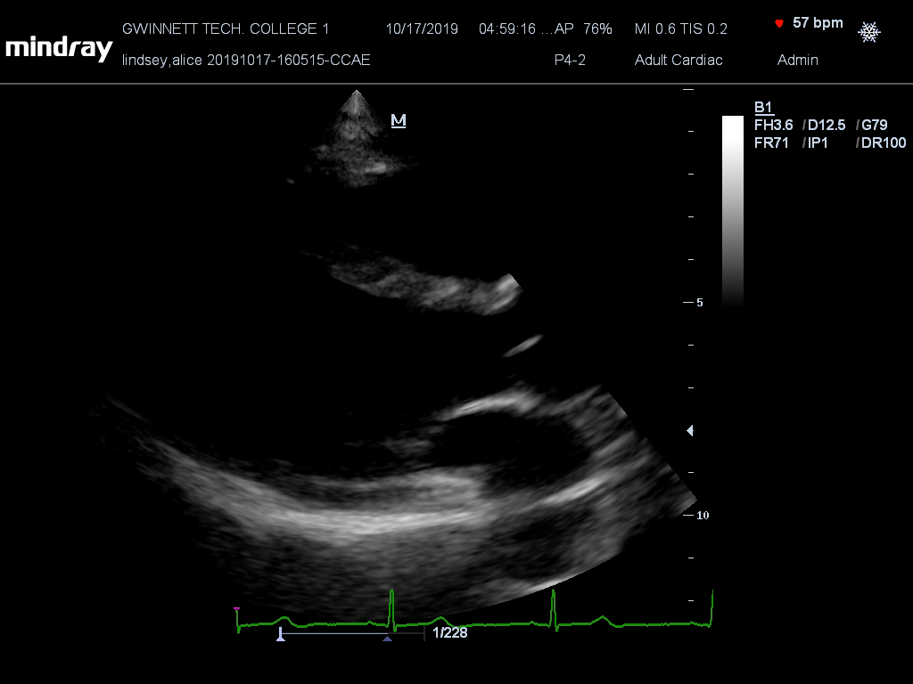

Slide 21
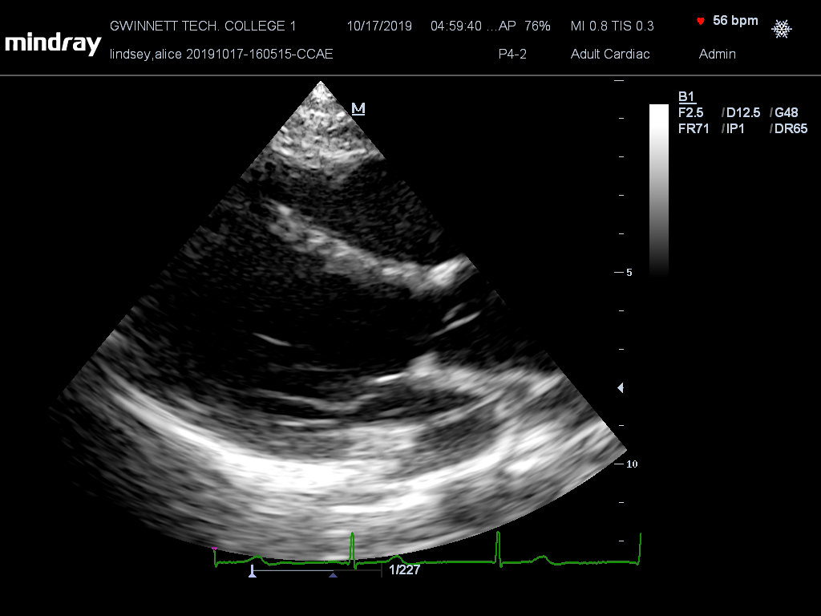

Slide 22
Summary
Created deeper
Created in tissues during transmission
Created by Nonlinear behavior in the speed of sound
Primarily created along beam’s main axis
No Harmonic F at the skin’s surface
No distortion
Reduced noise

Slide 23
Pulse Inversion Harmonic Imaging
A form of harmonic imaging where positive and negative pulses are transmitted down each scan line.
Deconstructive interference in the fundamental F
Constructive interference with Harmonics F
Disadvantage - the frame rate is half that of fundamental imaging.
Pulsed inversion imaging degrades temporal resolution while improving image accuracy

Slide 24
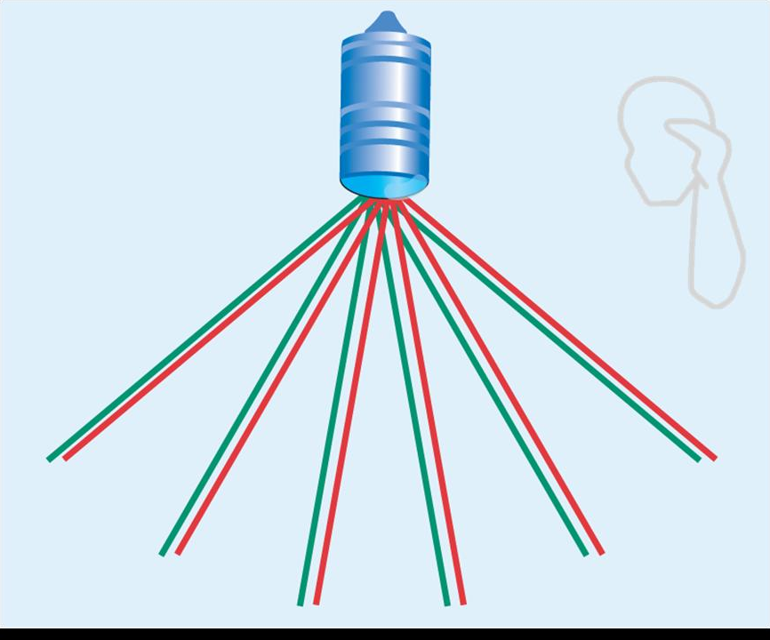
Pulse Inversion Harmonic Imaging
With pulse inversion, a positive and then a negative pulse is transmitted down each scan line

Slide 25
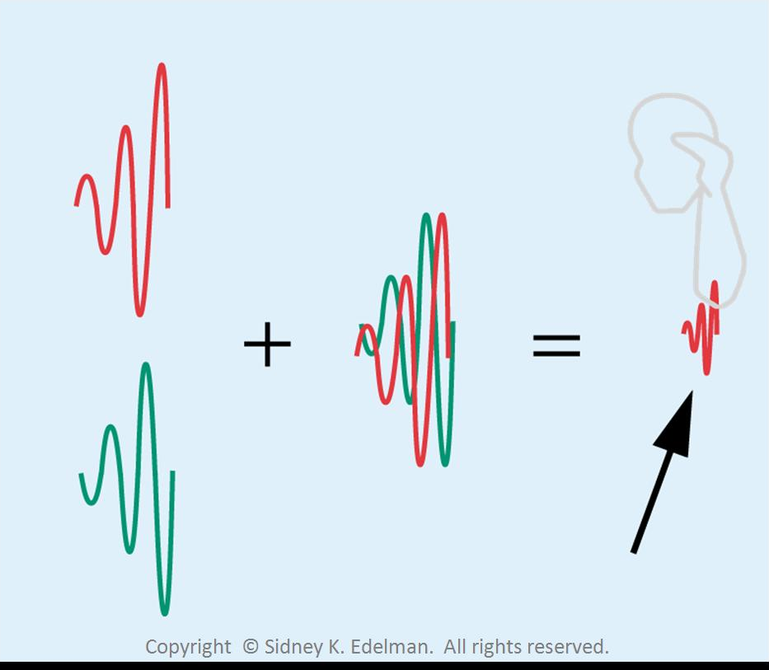
Pulse Inversion Harmonic Imaging
Positive and negative reflections are combined. The fundamental portions are eliminated, leaving only the harmonic part of the reflection

Slide 26
Power Modulation Harmonic Imaging
Same goals as pulse inversion but uses a different engineering approach
2 pulses but 2nd is twice the strength of the first
1st pulse has no HF only the 2nd stronger pulse
During reception
1st reflections are doubled then subtracted from second reflection
Fundamental portion cancel each other leaving only the harmonic

Slide 27
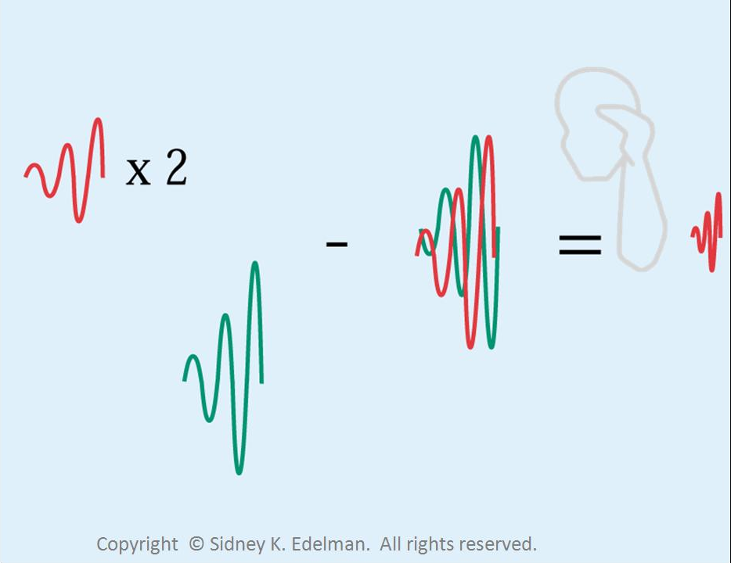
Power modulation harmonic imaging
The harmonics are extracted by sending one strong pulse and one weak pulse down each scan line

Slide 28
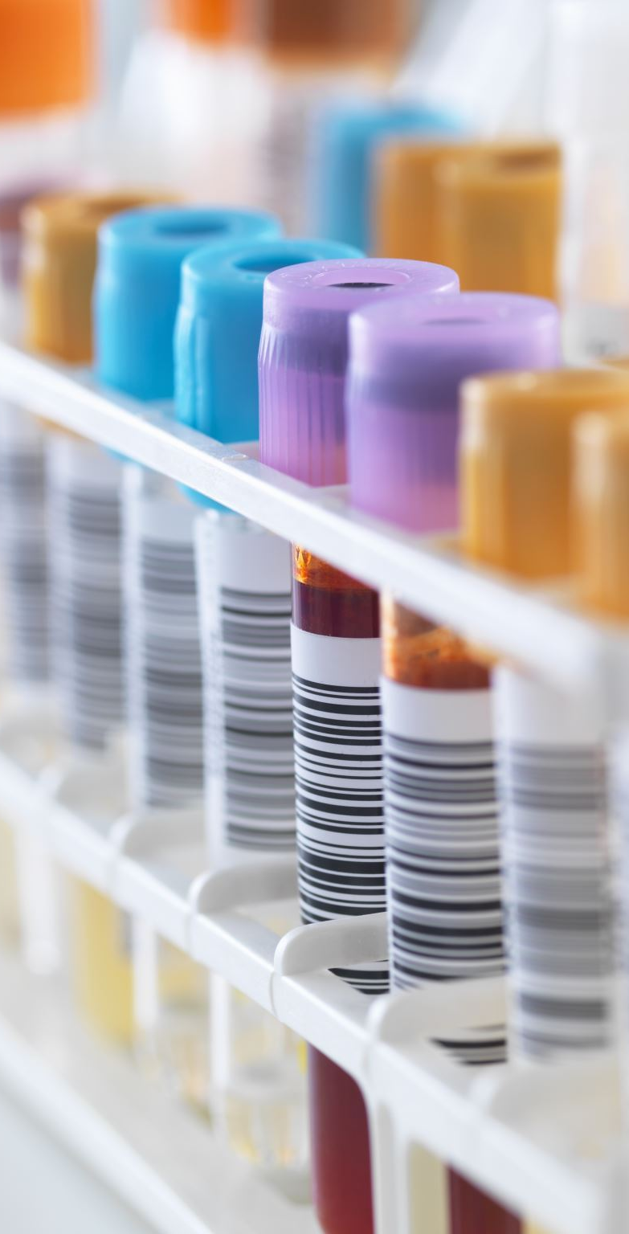
Contrast Agents
Substances used to enhance the contrast of structures or fluids within the body in medical imaging
Contrast agents can be ingested or injected (depending on the type of study)
Commonly used to enhance the visibility of blood vessels and the gastrointestinal tract

Slide 29
Contrast agents must be:
Safe
Metabolically inert
Long lasting
Strong reflector of ultrasound
Small enough to pass through capillaries

Slide 30
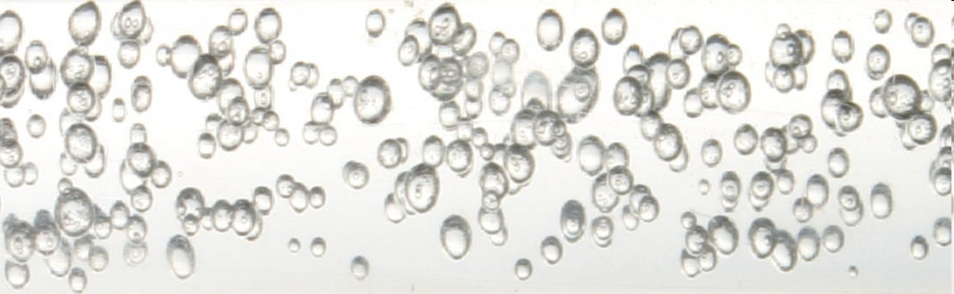
Ultrasound Contrast Agents
Contrast harmonics created during REFLECTION
Microbubbles act in nonlinear manner
Sound wave interacts with microbubble
Bubble grows and shrinks
Contrast harmonics created when bubbles interact with a STRONG beam
RESONANCE - nonlinear behavior of microbubbles
Bubbles expand to greater extent than they contract
Peak rarefaction pressure is most important with regards to contrast harmonics

Slide 31
Mechanical Index (MI)
Amount of contrast harmonics is estimated by this number
Increases with lower F sound and stronger sound waves
MI= peak rarefaction pressure
√F
The relationship between MI and harmonic creation is nonlinear

Slide 32
Mechanical Index (MI)
Low MI beams do not create harmonics
< 0.1
Intermediate beams- small amount of harmonics
0.1 to 1.0
High MI beams- create substantial harmonic signals
> 1.0
Bubbles may expand and break apart

Slide 33
Ultrasound Contrast Agents Characteristics
IMPORTANT
nature of the outer shell
Trap gas and increase life
Without shells vanish quickly
Flexible so can change shape, rigid shells fracture
the gas that fills the microbubble
Determines stability
Smaller molecules more likely to leak thus bubble shrinks
Larger molecules- shell less permeable so molecules remain in trapped
Determines
Stability and longevity in the blood

Slide 34
Ultrasound Contrast Agents Characteristics
Microbubbles of gas entrapped in a shell
Have a different acoustic fingerprint than blood or tissue. (Meaning they look different sonographically)
These are injected into bloodstream
Create strong reflections that “light up” heart chambers or vessels.
These are safe, last a long time, have no effect on the body

Slide 35
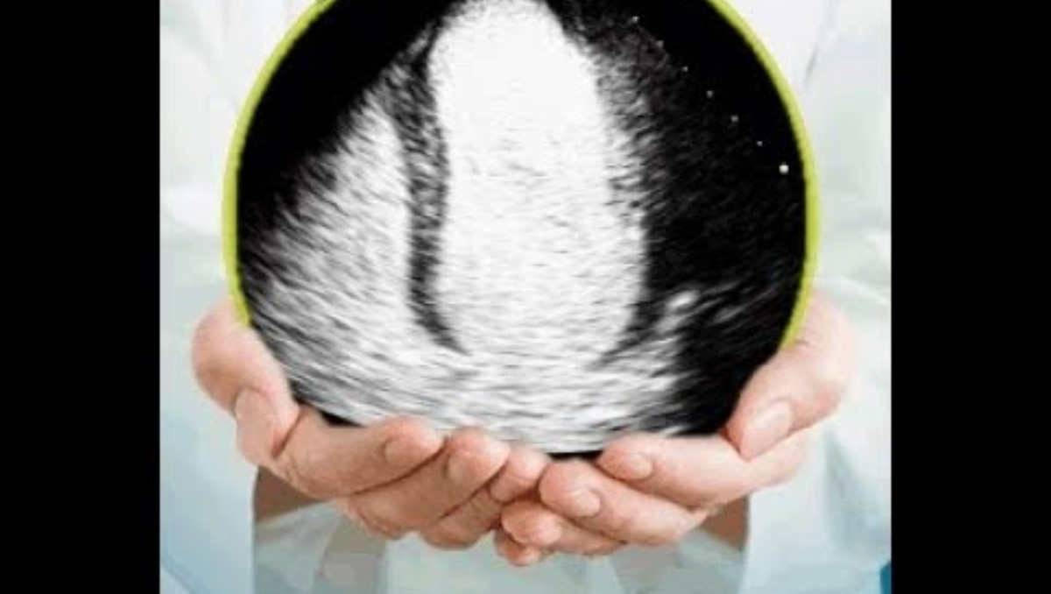
How is contrast used in Echocardiography?

Slide 36
Summary
Created during reflection
Created by Nonlinear behavior of microbubble
Related to the Mechanical Index
Affected by microbubble’s shell and gas within
System manufacturers and developers of contrast agents work together to create optimal agents.

